Slide 1

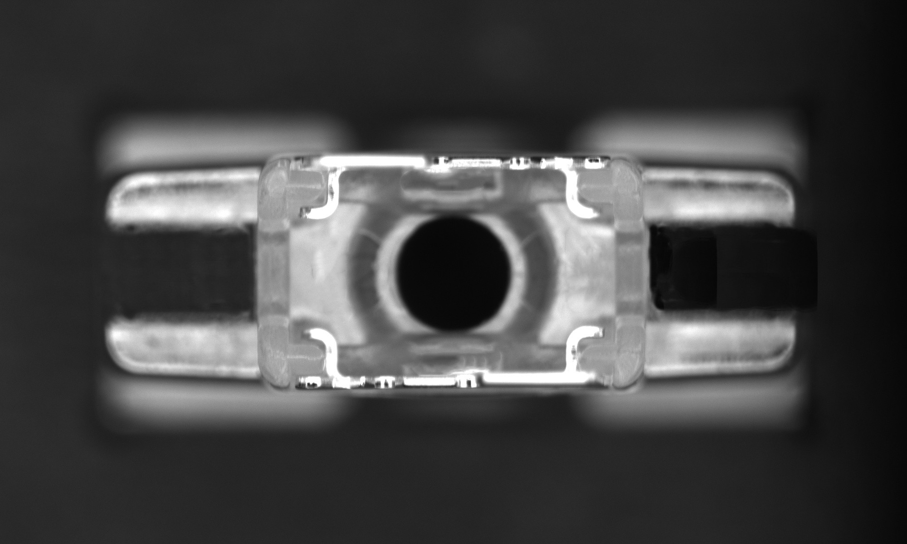
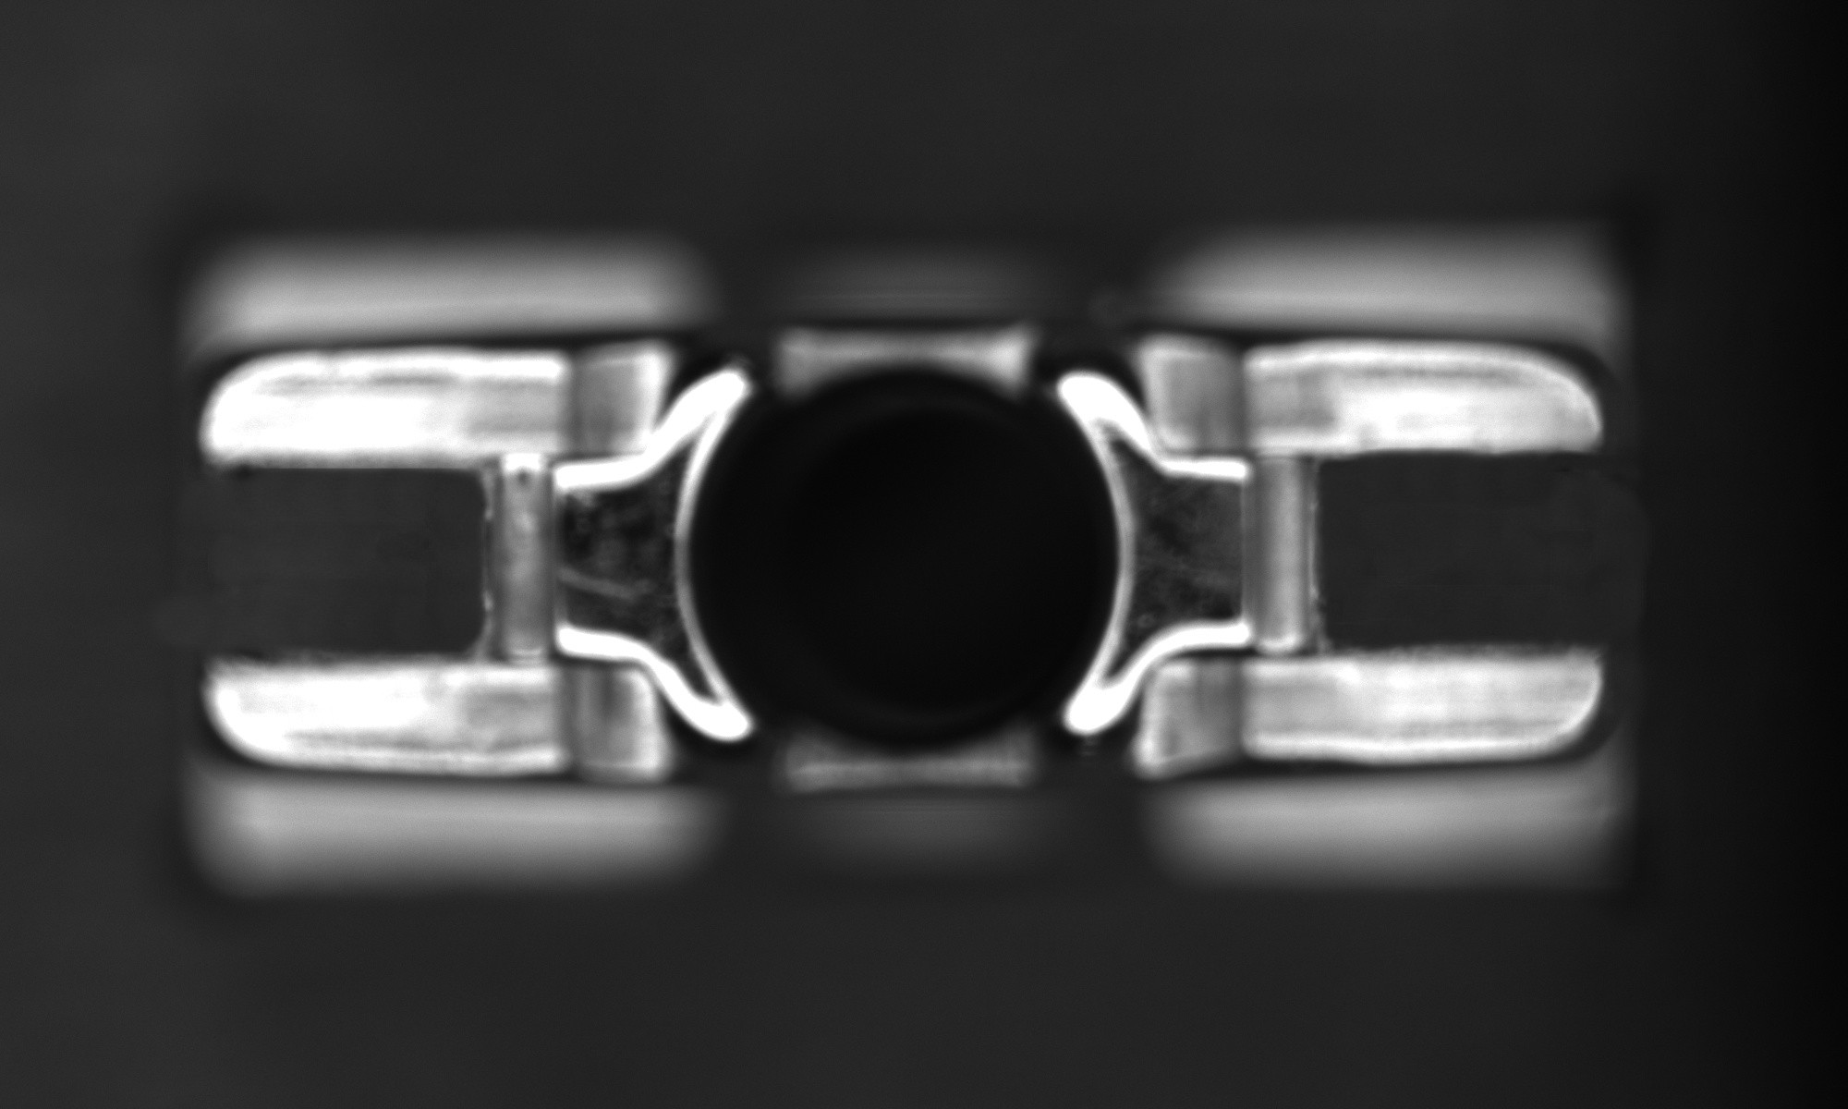
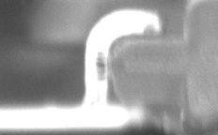
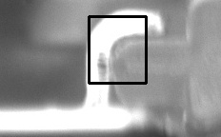
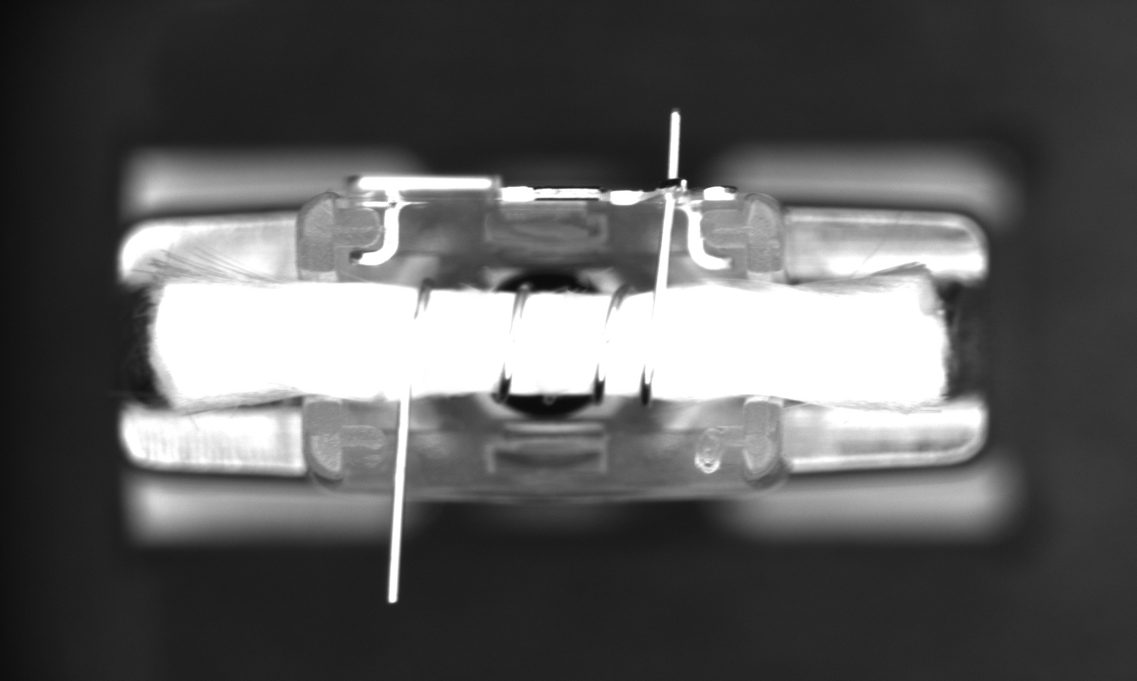
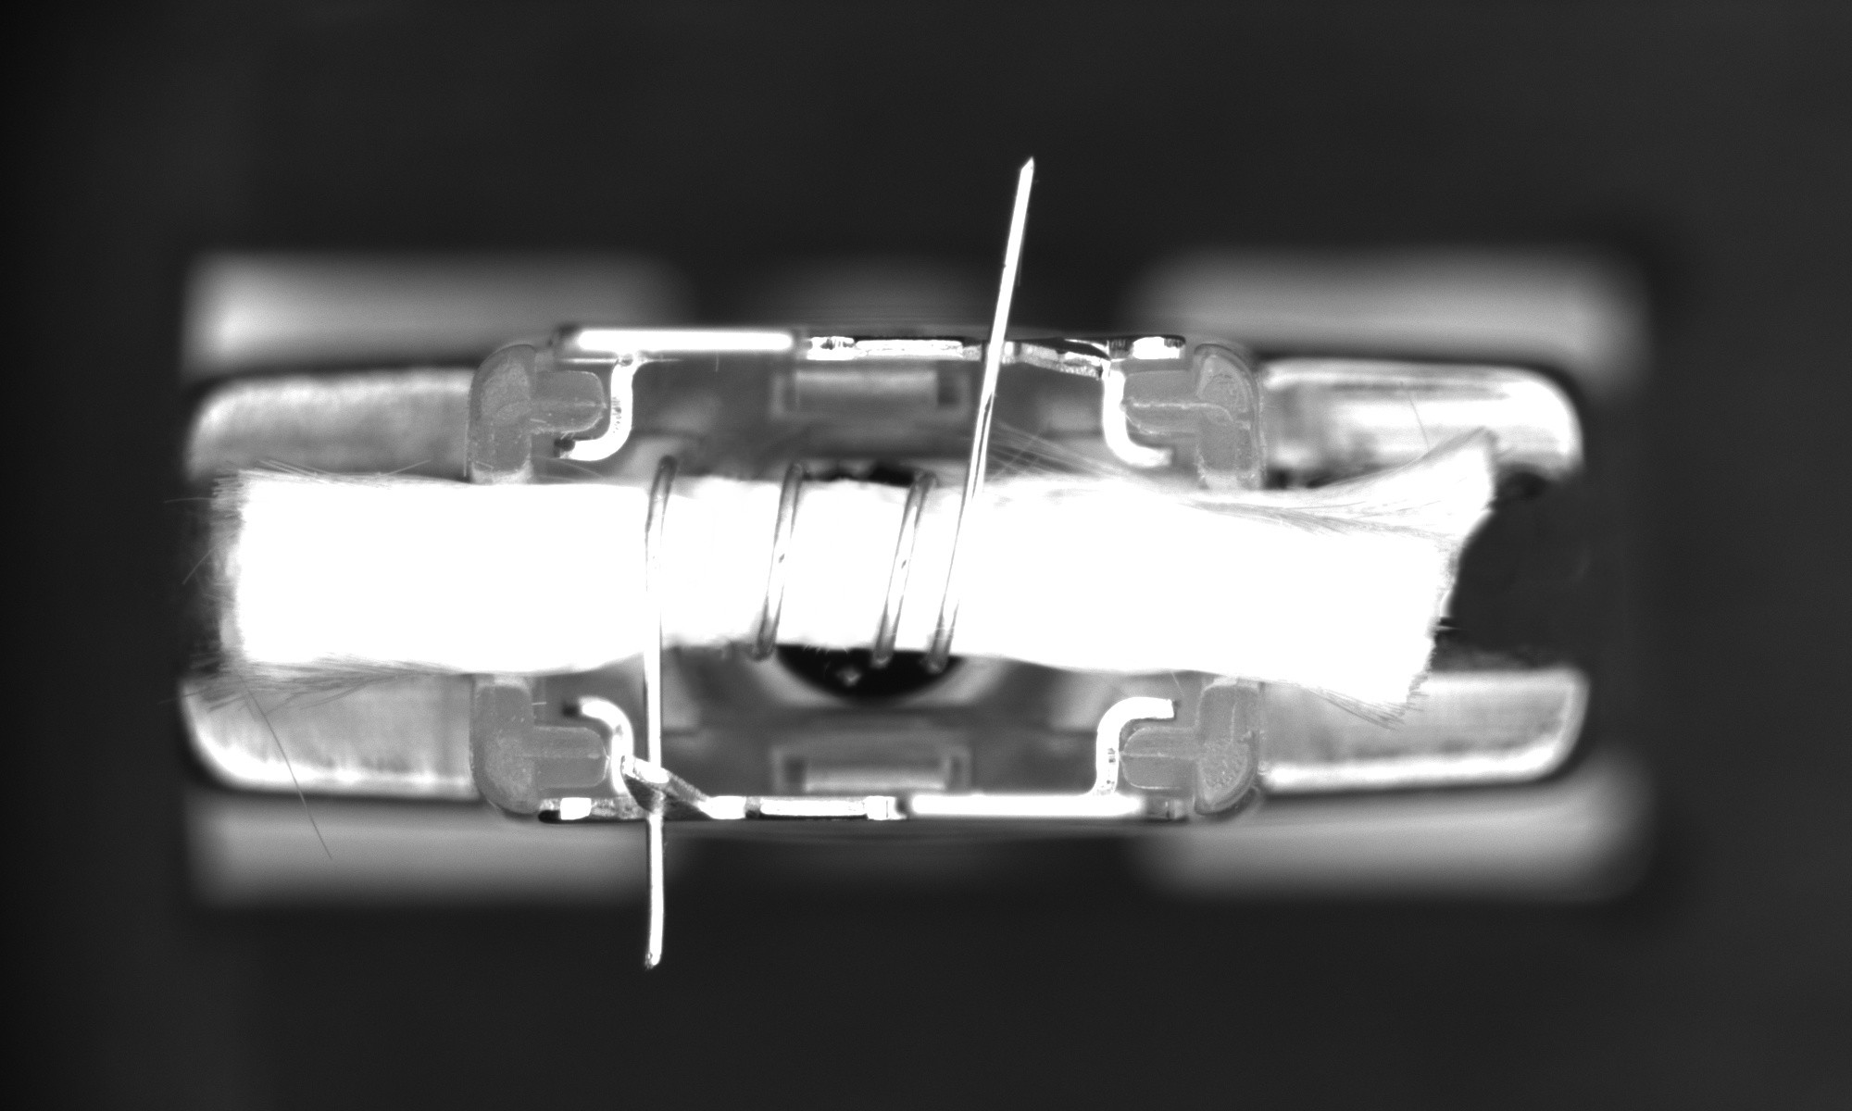
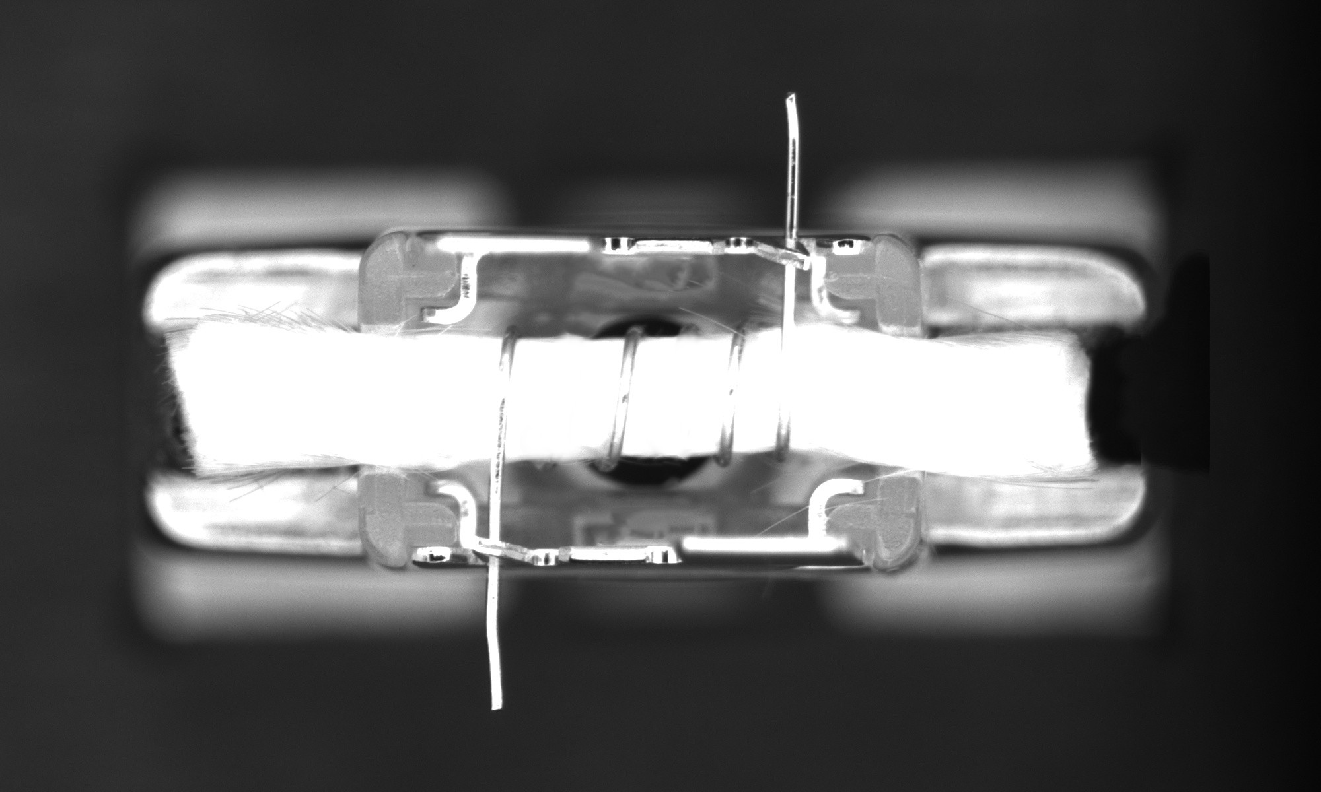
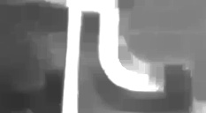

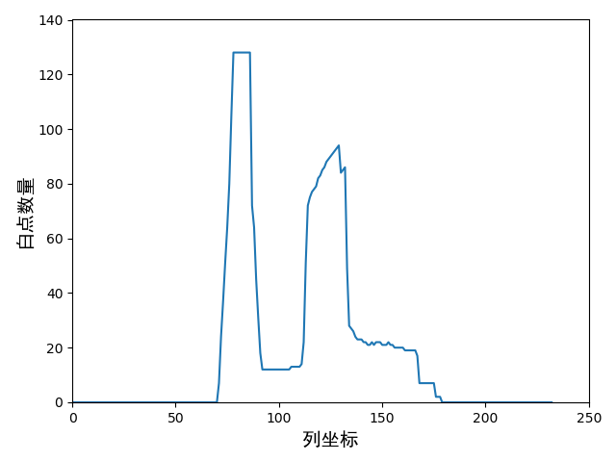
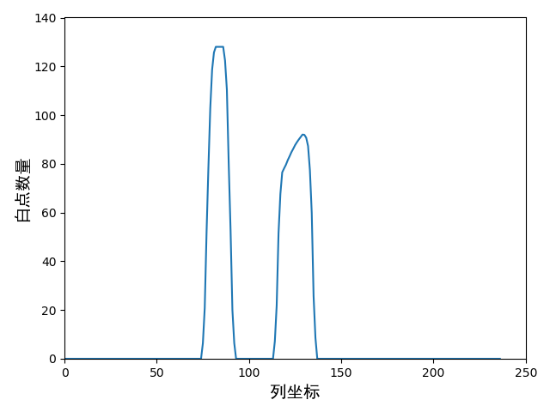
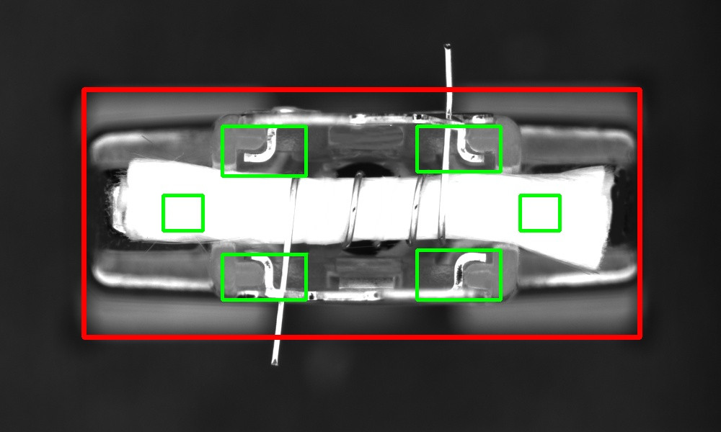
CACRE 2019 C019
Assembly Defect Detection of Atomizers Based on Machine Vision
Jiankun Wang and Hong Hu Department of Mechatronic Engineering Harbin Institute of Technology, Shenzhen honghu@hit.edu.cn
Long Chen and Caiying He Technology Center Shenzhen Colibri Technologies Co. Ltd longchen@colibri.com.cn
Introduction
In industrial automated production, in order to ensure the quality of the product it is necessary to perform defect detection in order to eliminate defective products. The research object of this paper is an atomizer. The assembly defects of an atomizer can be divided into four types: missing workpiece, missing cotton core, missing metal sheet, and abnormal wire position. Defect samples are shown in Figure 1. This paper proposes two algorithms for detecting atomizer assembly defects. One is the image processing detection algorithm, and the other is the deep learning detection algorithm based on CNN. Our goal is to verify the feasibility of using deep learning algorithms for industrial inspection and to analyze the characteristics of two different algorithms.
missing workpiece missing cotton core
missing metal sheet abnormal wire position
normal
Figure 1: Samples of atomizer assembly defects
Image Processing Algorithm
1. Detection Target Location and ROI Setting
Step-1: Separate the foreground and background. We use fixed threshold binary segmentation.
Step-2: Fixture positioning. We applying an open operation to eliminate protruding wires. Then, a contour search is used on the image to obtain the outer rectangular outline of the fixture.
Step-3: The corresponding ROI is set according to the occurrence area of various defects. The position of the ROI can be determined based on the relative position of the assembly to the fixture. The ROI settings are shown in Figure 2.
Figure 2: Detection target location and ROI settings
2. Detection of Various Defects
For the detection of missing workpiece defect, the contour filtering method is proposed. Contour filtering is to filter the contour of a small area by setting the contour area threshold. The result of the contour filtering is used to judge whether the workpiece is missing. If there is no contour after contour filtering, it can be determined that the workpiece is missing.
For the detection of missing cotton core defect, a pixel statistical method is proposed. The cotton core is judged to be missing by counting the proportion of white pixels in the ROI. If the ratio is less than the threshold, it is determined that the cotton core is missing, and vice versa.
For the detection of missing metal sheet defect, the template matching method is used. The detection process of the sample with the metal piece is shown in Figure 3.
Figure 3: Detection of missing metal sheet
For the detection of abnormal wire position defect, a measurement distance method based on pixel statistics is proposed. According to the distance between the wire and the vertical side of the metal claw, we can judge whether the position of the wire is abnormal. The process of measuring the distance is shown in Figure 4.
original image pre-processed image
pixel statistics numerical smoothing
Figure 4: Distance measurement
Deep Learning Algorithm
1. Model Selection
We made a preliminary selection of the model. We selected several commonly used CNN networks to build deep learning models, including Alex, VGG, and MobileNetThe detection accuracy of each model and the detection time of a single picture are shown as Table 1.
From the table, it can be found that the MobileNet network has the highest accuracy and the shortest detection time. Therefore, we choose MobileNet for deep learning algorithm design.
2. Training Program Improvement
This paper proposes a new training program. Each sample used in model training consists of two pictures, one is a standard normal picture and the other is any picture in the datateset. The diagram of the training program is shown in Figure 5.
Figure 5: Sketch of training program
Experiment
We used the image processing algorithm and the deep learning algorithm with the original and proposed training program for defect detection. The test results of the algorithms are shown in Table 2, 3 and 4, respectively.
From the table 3 and 4, we can know that the detection accuracy of proposed training program is improved compared to original training program. From table 2 and 4, we can know that image processing algorithm has better defect detection accuracy, while deep learning algorithm has better normal category detection rate.
Conclusion
This paper proposes two algorithms to detect the assembly defects of the atomizer. We designed a corresponding image processing detection algorithm for different assembly defects. We also proposed a deep learning detection algorithm based on the MobileNet network and our training program. Both algorithms have their own advantages and disadvantages.
Table 1. Accuracy And Detection Time Of Models
Model | Accuracy | Detection time
Alex | 92.61% | 24.78ms
VGG | 63.04% | 105.30ms
MobileNet | 97.83% | 5.31ms
normal
image
Model
image dataset
one sample
Table 2. Result Of Image Processing Algorithm
Defect | Detection rate | Error rate
Missing workpiece | 100% | 0%
Missing cotton core | 100% | 0%
Missing metal sheet | 100% | 0.43%
Abnormal wire position | 100% | 0.85%
Normal | 98.72% | 0%
Table 3. Result Of Original Deep Learning Algorithm
Defect | Detection rate | Error rate
Missing workpiece | 100% | 0%
Missing cotton core | 100% | 0%
Missing metal sheet | 100% | 1.41%
Abnormal wire position | 83.33% | 0%
Normal | 97.93% | 2.35%
Table 4. Result Of Proposed Deep Learning Algorithm
Defect | Detection rate | Error rate
Missing workpiece | 100% | 0%
Missing cotton core | 100% | 0%
Missing metal sheet | 100% | 0%
Abnormal wire position | 83.33% | 0%
Normal | 100% | 2.35%

